Slide 1
National Budget Call FY 2024
Reminders in Accomplishing Agency Tier 2 Budget Proposals

Slide 2
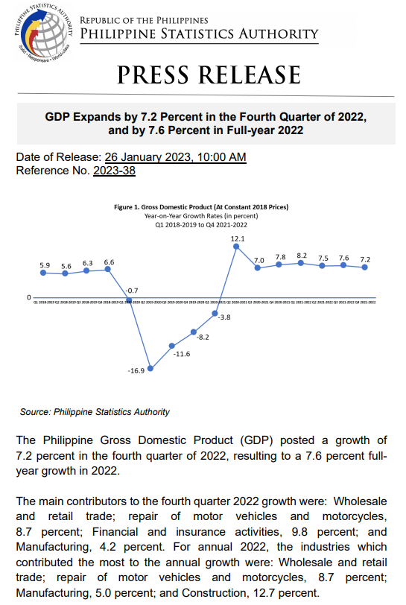
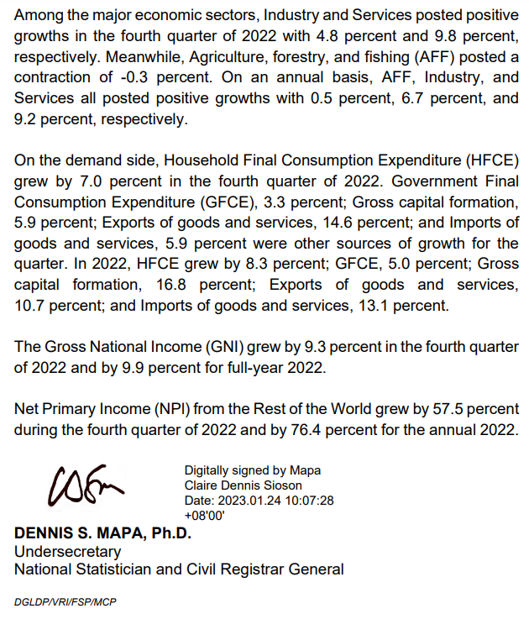
Furthering Our Pursuit of Economic Transformation

Slide 3
Guidelines in the Formulation of Agencies’ Tier 2 Levels
Annex A of the FY 2024 National Budget Call

Slide 4
Two-tier Budgeting Approach (2TBA):
More Focused Budgeting
Separates the discussions and deliberations for ongoing/existing programs/projects and entirely new spending measures/proposals, including the expansion of the ongoing/existing.
3 Main Objectives:
Streamline the budget preparation process.
Enhance the accountability of departments/agencies to prioritize and manage spending.
Engage the President and the Cabinet in setting the strategic direction and distribution of the unallocated fiscal place.

Slide 5
Definition of Tier 2 Proposals
TIER 1
TIER 2
NEP
Ongoing Spending
New Spending Proposals
Total President’s Budget Proposal to Congress
The Amount available for Tier 2 proposals corresponds to the fiscal space, pertaining to:
Projected expenditure program* minus
Tier 1; and the
Financial impact of the Mandanas ruling and the full devolution of certain functions to LGUs (EO No. 138, s. 2021)
* After considering projected revenue and deficit targets

Slide 6
Composition
New and Expanded Tier 2 proposals that are:
High Priority;
Implementation Ready;
Infrastructure PAPs included in the Public Investment Program (PIP) 2023-2028 and Three-Year Rolling Infrastructure Program 2024-2026*; and
Approved by the NEDA Board and/or the Investment Coordination Committee as of March 31, 2023 (if not yet included in Tier 1)
Scaling up/expansion of PAPs retained for implementation in terms of policy change(s) that were not previously approved (i.e., in terms of scope, beneficiaries, design, or implementation schedule)
Essential operations, maintenance, asset replacement and minor capital costs, including funding required for technical assistance programs to LGUs and those under the Organizational Effectiveness Proposals (OEPs) of agencies as a result of the devolution of certain functions to LGUs
* NEDA issued a Joint Call for the Formulation of the PIP 2023-2028 and TRIP 2024-2026 as Input to the FY 2024 Budget Preparation dated October 7, 2022

Slide 7
8-Point Socioeconomic Agenda
of the Marcos Administration
1 Protect purchasing power and mitigate socioeconomic scarring by ensuring food security, reducing transport and logistics costs, and reducing energy costs to families
3 Ensure sound macroeconomic fundamentals by enhancing bureaucratic efficiency and sound fiscal management and ensuring a resilient and innovative financial sector
2 Reduce vulnerability and mitigate scarring from the COVID-19 pandemic by tackling health, strengthening social protections, and addressing learning losses
4 Create more jobs by promoting trade and investments, improving infrastructure, and achieving energy security

Slide 8
8-Point Socioeconomic Agenda
of the Marcos Administration
5 Create quality jobs by increasing employability, encouraging research and development and innovation, enhancing digital economy
7 Uphold public order and safety, peace, and security
6 Create green jobs by pursuing green economy and establishing livable and sustainable communities
8 Ensure a level playing field by strengthening market competition and reducing barriers to entry and limits to entrepreneurship

Slide 9
8-Point Socioeconomic Agenda
Near-Term
Medium-Term
Protect the Purchasing Power of Families
Ensure Food Security
Reduce transport and logistics cost
Reduce energy cost to families
Reduce Vulnerability and Mitigate Scarring from the COVID-19 Pandemic
Tackle Health
Strengthen social protection
Safely reopen face-to-face education
Ensure Sound Macroeconomic Fundamentals
Enhance bureaucratic efficiency
Pursue sound fiscal management
More Jobs
Promote investments
Improve infrastructure
Ensure energy security
Quality Jobs
Increase employability
Expand and improve digital infrastructure
Encourage R&D and innovation
Green Jobs
Adopt a green (and blue) economy roadmap
Establish livable and sustainable communities

Slide 10
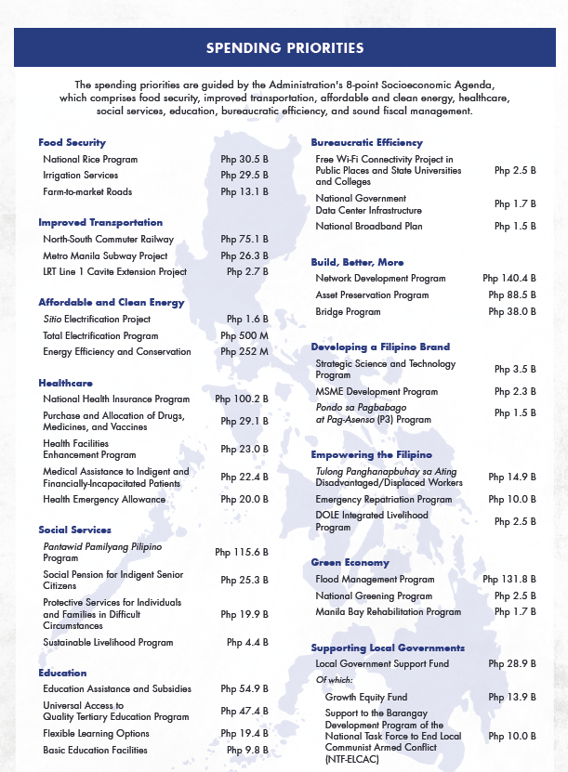

Slide 11
Details of Tier 2 Proposals
Personnel Services – For Inclusion in Agency PS Budget
FY 2023 Budget Call (NBM No. 142) | FY 2024 Budget Call (NBM No. 145)
Adjustments in PS due to budget policy decisions such as: - Implementation of a new program or activity - Abolition or expansion of PAP - Major change in organizational structure - Transfer of functions between agencies | Retained
Additional Casual and Contractual positions for duly established and functioning ad-hoc bodies coexistent with the operations of the particular ad-hoc units. | Additional Casual and Contractual positions for ongoing/new/expanded programs, project and activities, coexistent with the operations of such programs, projects and activities, subject to the submission of BP 204

Slide 12
Details of Tier 2 Proposals
PS – For Inclusion in Miscellaneous Personnel Benefits Fund
FY 2023 Budget Call (NBM No. 142) | FY 2024 Budget Call (NBM No. 145)
100% of the PS cost of new positions and staffing modifications approved by the DBM after December 31, 2021 | 100% of the PS cost of new positions and staffing modifications approved by the DBM after December 31, 2022, up to the prescribed cutoff date.
75% of the PS cost of positions proposed for creation and staffing modifications with legal basis, established standards, or with evaluation based on complete agency submission of documentary requirement | Up to 75% of the PS cost of positions proposed for creation and staffing modifications with legal basis, established standards, or with evaluation based on complete agency submission of documentary requirement
Step Increment due to Meritorious Performance per CSC-DBM JC No. 2012-1 | Retained
Proposed overtime pay requirements per CSC-DBM JC No. 2015-2 | Retained

Slide 13
Updating of the Personal Services Itemization and Plantilla of Personnel (PSIPOP)
Provided under National Budget Circular No. 549 dated October 21, 2013
NGAs with authorized permanent positions shall review the PSIPOP and update the POP portion on a MONTHLY basis and uploaded to the DBM GMIS database every last week of the month starting October 2013
Objectives:
To obtain real-time data on the status of agency staffing, particularly the number of filled and unfilled positions
To have a reliable basis for updating/determining the agency’s Personnel Services (PS) requirements, minimizing requests for PS deficiency against the MPBF
To serve as basis for appointments to positions
To tag the positions to the appropriate PAPs for greater accuracy of budget allocation for PAPs in the Budget

Slide 14
Details of Tier 2 Proposals
PS – For Inclusion in Pension and Gratuity Fund
FY 2023 Budget Call (NBM No. 142) | FY 2024 Budget Call (NBM No. 145)
TL and RG for optional retirees | TL and RG for optional retirees, subject to submission of BP Form 205
Pension payments for new retirees for Military/Uniformed Personnel, and agencies covered by special laws, i.e., OSG, OGCC, NLRC, PRC, ERC, LRA, DOJ-National Prosecution Service, and PAO | Retained
Monetization of Leave Credits | Retained
Separation benefits and/or incentives of affected personnel pursuant to reorganization, streamlining, rightsizing, devolution of functions to local government units, merger/consolidation, abolition, privatization, and other forms of organizational structuring authorized under applicable laws, rules and regulations | Retained
May be transferred to Agency Budget during Tier 2 deliberation: Pension payments for new retirees under CFAG, i.e., Judiciary and Ombudsman | Retained

Slide 15
Details of Tier 2 Proposals
Maintenance and Other Operating Expenses – For Inclusion in Agency MOOE Budget
FY 2023 Budget Call (NBM No. 142) | FY 2024 Budget Call (NBM No. 145)
Funding requirements to cover new or expanded existing PAPs, as identified under the PDP and BPF. | Retained
MOOE costs to implement approved major changes in the organization or structure of an agency, including downsizing or mergers. | Retained
MOOE costs not included in the FEs: Due to changes in demand-driven parameters of Medium-Term Expenditure Plans (MTEP); and Already approved rolling development or expansion plans. | Retained
Proposed resources needed for pursuing initiatives in promoting and enhancing agency performance, including improved public service delivery. | Retained
Expanded/new ICT PAPs with BP Form 202, which are in accordance with the agency’s Information Systems Strategic Plan consistent with the guidelines to be issued by the DICT. | Expanded/new ICT PAPs with BP Form 202, which are in accordance with the DICT-endorsed ISSP consistent with the guidelines to be issued by the DICT and such other guidelines to be issued for the purpose.

Slide 16
Details of Tier 2 Proposals
Maintenance and Other Operating Expenses – For Inclusion in Agency MOOE Budget
FY 2023 Budget Call (NBM No. 142) | FY 2024 Budget Call (NBM No. 145)
New/expansion of subsidy support to LGUs. | New/expansion of infrastructure subsidy/equity support to GOCCs and LGUs.
Maintenance costs and spare parts for projects to be completed by 2022. | Maintenance costs and spare parts for projects to be completed by 2023.
Adjustments based on submission of certifications not received before the deadline of the submission of Tier 1 for the funding requirements to cover the transfers from the NG to the LGUs as mentioned in Tier 1. | Retained
New major capital projects to be implemented starting FY 2023, and ongoing major capital projects with updated project scope/cost, implementation and loan validity schedule, and source of financing approved by the NEDA Board and/or ICC-Cabinet Committee as of March 31, 2022. | New major capital projects to be implemented starting FY 2024, and ongoing major capital projects with updated project scope/cost, implementation and loan validity schedule, and source of financing approved by the NEDA Board and/or ICC-Cabinet Committee as of March 31, 2023.

Slide 17
Details of Tier 2 Proposals
Maintenance and Other Operating Expenses – For Inclusion in Agency MOOE Budget
FY 2023 Budget Call (NBM No. 142) | FY 2024 Budget Call (NBM No. 145)
New foreign-assisted projects due for negotiation in FY 2022 and implementation in FY 2023 as contained in the programming documents of the lending institutions/donor/grantor as certified by the DOF. These shall be evaluated by the DBM for possible inclusion of the loan proceeds component under the Unprogrammed Appropriations. | New foreign-assisted projects due for negotiation in FY 2023 and implementation in FY 2024 as contained in the programming documents of the lending institutions/donor/grantor as certified by the DOF. These shall be evaluated by the DBM for possible inclusion of the loan proceeds component under the Unprogrammed Appropriations.

Slide 18
Details of Tier 2 Proposals
MOOE – For Inclusion in the Budget for Allocation to LGUs
FY 2023 Budget Call (NBM No. 142) | FY 2024 Budget Call (NBM No. 145)
None | Adjustments based on submission of certifications received beyond the deadline of the submission of Tier 1 for the funding requirements to cover the transfers from the NG to the LGUs as mentioned in Tier 1*
* National Tax Allotment (NTA), Special Shares of LGUs in the Proceeds of National Taxes, Barangay Official Death Benefits, Special Shares of LGUs in the Proceeds of Fire Code Fees, and Local Government Support Fund

Slide 19
Details of Tier 2 Proposals
Capital Outlays – For Inclusion in Agency CO Budget
FY 2023 Budget Call (NBM No. 142) | FY 2024 Budget Call (NBM No. 145)
Proposed new infrastructure projects included in the approved FY 2023-2025 TRIP. | Proposed new infrastructure projects included in the approved FY 2024-2026 TRIP.
New major capital projects to be implemented starting FY 2023, and ongoing major capital projects with updated project scope/cost, implementation and loan validity schedule, and source of financing approved by the NEDA Board and/or ICC-Cabinet Committee as of March 31, 2022. | New major capital projects (infrastructure/non-infrastructure in nature), which are implementation-ready to be implemented starting FY 2024, with BP Form 202 and ongoing major capital projects (infrastructure/non-infrastructure in nature), with updated project scope/cost, implementation per BP Form 202 and loan validity schedule, and source of financing approved by the NEDA Board and/or ICC-Cabinet Committee as of March 31, 2023.
Proposed requirements for the purchase of motor vehicles for additional/ newly-entitled officials and/or functions of a newly-created agency. | Retained
Expanded/new ICT PAPs with BP Form 202, which are in accordance with the agency’s Information Systems Strategic Plan consistent with the guidelines to be issued by the DICT. | Expanded/new ICT PAPs with BP Form 202, which are in accordance with the DICT-endorsed ISSP consistent with the guidelines to be issued by the DICT and such other guidelines to be issued for the purpose.

Slide 20
Details of Tier 2 Proposals
Capital Outlays – For Inclusion in Agency CO Budget
FY 2023 Budget Call (NBM No. 142) | FY 2024 Budget Call (NBM No. 145)
New foreign-assisted projects due for negotiation in FY 2022 and implementation in FY 2023 as contained in the programming documents of the lending institutions/donor/grantor as certified by the DOF. These shall be evaluated by the DBM for possible inclusion of the loan proceeds component under the Unprogrammed Appropriations. | New foreign-assisted projects due for negotiation in FY 2023 and implementation in FY 2024 as contained in the programming documents of the lending institutions/donor/grantor as certified by the DOF. These shall be evaluated by the DBM for possible inclusion of the loan proceeds component under the Unprogrammed Appropriations.

Slide 21
Changes in the Contents of Annex B of the Budget Call vs Last Year
FY 2023 National Budget Call (National Budget Memorandum No. 142) vs FY 2024 National Budget Call (National Budget Memorandum No. 145)

Slide 22
Personnel Services BP Form 201-A

Slide 23
Specific Guidelines on the Allocation for Objects of Expenditure
FY 2023 Budget Call (NBM No. 142) | FY 2024 Budget Call (NBM No. 145)
Salaries and Wages Requests for Additional Casual and Contractual positions for duly established and functioning ad-hoc bodies, coexistent with the operations of the particular ad-hoc units, may be proposed in Tier 2. Moreover, positions for development projects to augment the core staff of the Project Office/Unified PMO may be created, subject to the scrap and build policy and the provisions of NBC No. 485 dated March 13, 2003. | Salaries and Wages Requests for Additional Casual and Contractual positions for existing/new/expanded programs, activities, and projects, co-existent with the operations of such programs, activities, and projects, may be proposed in Tier 2. Moreover, positions for development projects to augment the core staff of the Project Office/Unified PMO may be created, subject to the scrap and build policy and the provisions of NBC No. 485 dated March 13, 2003.
Personnel Economic Relief Allowance (PERA) The PERA of P2,000.00/month shall cover all positions entitled thereto pursuant to Budget Circular (BC) No. 2009-3. The total amount shall be based on the number of filled itemized positions as of December 31, 2021. | Personnel Economic Relief Allowance (PERA) The PERA of P2,000.00/month shall cover all positions entitled thereto pursuant to Budget Circular (BC) No. 2009-3 as amended by BC No. 2011-2. The total amount shall be based on the number of filled itemized positions as of December 31, 2022.

Slide 24
Specific Guidelines on the Allocation for Objects of Expenditure
FY 2023 Budget Call (NBM No. 142) | FY 2024 Budget Call (NBM No. 145)
Cash Gift Cash Gift equivalent to P5,000.00 shall be computed based on the number of filled positions as of December 31, 2021. | Cash Gift Cash Gift equivalent to P5,000.00 shall be computed based on the number of filled positions as of December 31, 2022.
Year-End Bonus Year-end Bonus equivalent to one (1) month basic salary or base pay shall be computed based on the number of filled positions as of December 31, 2021. | Year-End Bonus Year-end Bonus equivalent to one (1) month basic salary or base pay shall be computed based on the number of filled positions as of December 31, 2022.
Mid-Year Bonus Mid-Year Bonus equivalent to one (1) month basic salary or base pay shall be computed based on the number of filled positions as of December 31, 2021. | Mid-Year Bonus Mid-Year Bonus equivalent to one (1) month basic salary or base pay shall be computed based on the number of filled positions as of December 31, 2022.
Productivity Enhancement Incentive (PEI) PEI equivalent to P5,000.00 shall be computed based on the number of filled positions as of December 31, 2021. | Productivity Enhancement Incentive (PEI) PEI equivalent to P5,000.00 shall be computed based on the number of filled positions as of December 31, 2022.

Slide 25
Specific Guidelines on the Allocation for Objects of Expenditure
FY 2023 Budget Call (NBM No. 142) | FY 2024 Budget Call (NBM No. 145)
Subsistence, Laundry, and Quarters Allowances (SLQA) The SLQA under the Magna Carta Benefits of Public Health Workers pursuant to R.A. No. 7305 shall be in accordance with the DBM-DOH JC No. 1, s. 2012 as amended by DBM-DOH JC No. 2016-01. The SLQA authorized for specific positions other than public health workers shall be computed based on the rates authorized under specific laws, rules and regulations. | Subsistence, Laundry, and Quarters Allowances (SLQA) The SLQA under the Magna Carta Benefits of Public Health Workers pursuant to R.A. No. 7305 shall be in accordance with the DBM-DOH JC No. 1, s. 2012 as amended by DBM-DOH JC No. 2016-01. The SLQA under the Magna for Scientists, Engineers, Researchers, and Other S&T Personnel in Government pursuant to R.A. No. 8439 shall be in accordance with the DBM-DOST Joint Circular No. 1, s. 2013. The SLQA authorized for specific positions other than public health workers, scientists, engineers, researchers, and other S&T Personnel in government shall be computed based on the rates authorized under specific laws, rules and regulations.
None | Hazard Allowance The Hazard Allowance under the Magna for Scientists, Engineers, Researchers, and Other S&T Personnel in Government pursuant to R.A. No. 8439 shall be in accordance with the DBM-DOST Joint Circular No. 1, s. 2013.

Slide 26
Specific Guidelines on the Allocation for Objects of Expenditure
FY 2023 Budget Call (NBM No. 142) | FY 2024 Budget Call (NBM No. 145)
Overseas Allowances The allowances of personnel assigned abroad such as overseas, living quarters, family, clothing, post and representation allowances shall be at rates authorized under R.A. No. 7157 and E.O. No. 156, s. 2013. | Allowances of Foreign Service Personnel Retained
None | Night Shift Differential Night Shift Differential shall be granted at a rate not exceeding 20% of the hourly basic rate of the government employee occupying positions from Division Chief and below or their equivalent whether permanent, contractual, temporary, or casual, for each hour of work performed between the hours of 6:00 in the evening and 6:00 in the morning of the following day, pursuant to RA No. 11701 and its Implementing Rules and Regulations to be issued by the Civil Service Commission.

Slide 27
MOOE BP Form 201-B

Slide 28
Specific Guidelines on the Allocation for Objects of Expenditure
FY 2023 Budget Call (NBM No. 142) | FY 2024 Budget Call (NBM No. 145)
None | Semi-expendable Expenses This covers budget proposals for the purchase of tangible items which meet the definition and recognition criteria of Property, Plant and Equipment but the cost is below Fifty Thousand Pesos (P50,000.00) shall be regarded as semi-expendable property in accordance with COA Circular No. 2022-004.
None | The engagement/procurement and payment of the services of Contract of Service and Job Order workers shall be made in accordance with COA-DBM JC No. 2, s. 2020, as amended by COA-DBM JC No. 2, s. 2022.
None | Bank Transaction Fee Per Annex A of COA Circular No. 2020-001, this covers budget proposal for the charges imposed by the bank for various services rendered, not related to loans/borrowings, excluding interest charges. This also includes cost of checkbooks, penalties and surcharges on overdraft, telegraphic transfers and the like.

Slide 29
Financial Expenses BP Form 201-C

Slide 30
Specific Guidelines on the Allocation for Objects of Expenditure
FY 2023 Budget Call (NBM No. 142) | FY 2024 Budget Call (NBM No. 145)
Estimated amounts for Financial Expenses should be assigned to the relevant UACS category. No amounts should be provided for ‘Other Financial Charges’ | Estimated amounts for Financial Expenses, i.e., Management Supervision/Trusteeship Fees, Interest Expenses, Guarantee Fees, Bank Charges-Loans and Borrowings, and Commitment Fees consistent with the COA Revised Chart of Accounts (Updated 2019) as outlined in the Government Accounting Manual. The use of the ‘Bank Charges’ sub-object covers the charges imposed by the bank for various services rendered in relation to loans or borrowings. It also excludes interest charges. This is also in accordance with COA Circular No. 2020-001. No amounts should be provided for ‘Other Financial Charges’

Slide 31
Capital Outlays BP Form 201-D

Slide 32
Specific Guidelines on the Allocation for Objects of Expenditure
FY 2023 Budget Call (NBM No. 142) | FY 2024 Budget Call (NBM No. 145)
Transportation Equipment Outlay The acquisition by government offices of luxury vehicles shall continue to be prohibited. Proposals for the purchase of motor vehicles shall be subject to pertinent provisions of the General Appropriations Act, NBC Nos. 446 and 446-A, BC Nos. 2010-2, 2017-1 and 2019-2, OP Memorandum Circular No. 9, s. 2010 and AO No. 14 s. 2018, and such other guidelines that may be issued by the DBM. Motor vehicles that should be replaced shall likewise be determined in accordance with the provisions of NBC No. 446 and such other guidelines that may be issued by the DBM | Transportation Equipment Outlay The acquisition by government offices of luxury vehicles shall continue to be prohibited. Proposals for the purchase of motor vehicles shall be subject to pertinent provisions of the General Appropriations Act, BC No. 2022-1, OP Memorandum Circular No. 9, s. 2010 and AO No. 14 s. 2018, and such other guidelines that may be issued by the DBM. Motor vehicles that should be replaced shall likewise be determined in accordance with the provisions of BC No. 2022-1 and such other guidelines that may be issued by the DBM

Slide 33
Specific Guidelines on the Allocation for Objects of Expenditure
FY 2023 Budget Call (NBM No. 142) | FY 2024 Budget Call (NBM No. 145)
ICT-related Expenditures DICT-DBM-NEDA Joint Memorandum Circular (JMC) No. 2021-01 provides information on the winding up of the conduct of MITHI. In line with this, agency budget proposals for ICT P/A/Ps will no longer be processed through the MITHI Steering Committee (MSC). However, the management, review, and monitoring of the ISSPs remains to be a function of DICT pursuant to the same JMC | ICT-related Expenditures ICT-related proposals, under the objects/sub-objects of expenditures listed in ‘Annex B-2’, shall be included in the agency’s ISSP which shall be prepared subject to the compliance with the rules and regulations issued by the DICT and such other guidelines to be issued for the purpose.

Slide 34
Thank you!

