Slide 1
DEPARTMENT OF BUDGET AND MANAGEMENT
Office of the Chief Information Officer
Information and Communications
Technology Updates
Budget Forum
26-27 January 2023

Slide 2
AGENDA
Digital Transformation Initiatives
Program Convergence Budgeting
Online Submission of Budget Proposals
OFFICE OF THE CHIEF INFORMATION OFFICER

Slide 3
DIGITAL TRANSFORMATION
ICT Budget Proposals
Standardization Cost
Joint Memorandum Circular No. 2021-01 (DICT-DBM-NEDA)-Winding the Conduct of MITHI
ISSP Design Thinking Workshop
Collaboration on IT Projects Monitoring
OFFICE OF THE CHIEF INFORMATION OFFICER

Slide 4
DIGITAL TRANSFORMATION
Digital Transformation on ICT Initiatives
ICT Budget Proposals
Standardization Cost
Digitalization of ISSP submission (Portal)
Workshop scheduled on February 2023
With tagging facility on:
Interoperability
Emerging Technologies
Cloud Services
API
ISSP Design Thinking Workshop
Collaboration on IT Projects Monitoring
OFFICE OF THE CHIEF INFORMATION OFFICER

Slide 5
Implementing the PCB Approach
PROGRAM CONVERGENCE BUDGETING
P
Agency 5
P
Agency 6
P
P
Agency4
DICT (Lead)
Agency3
Agency2
Agency1
OFFICE OF THE CHIEF INFORMATION OFFICER

Slide 6
Enrolment of the
Digital Transformation Cluster in the PCB
PROGRAM CONVERGENCE BUDGETING
OFFICE OF THE CHIEF INFORMATION OFFICER

Slide 7
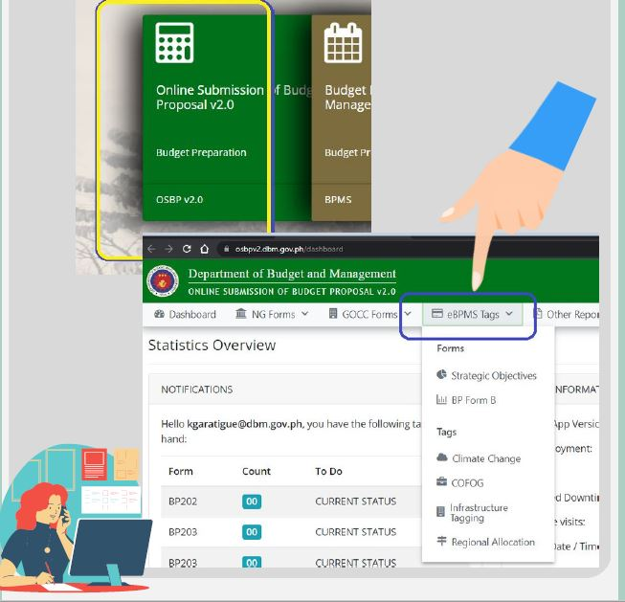
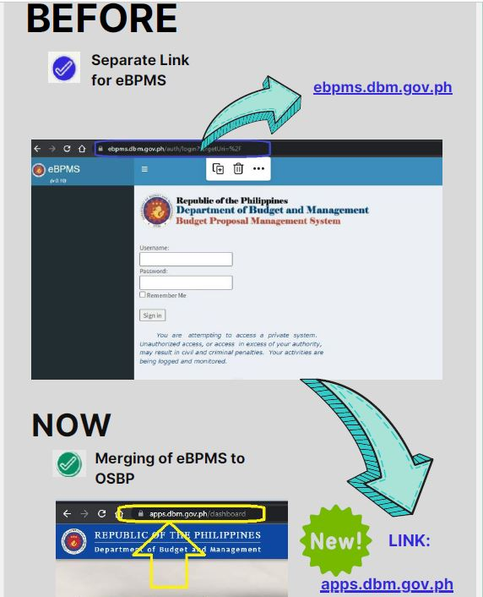
ONLINE SUBMISSION OF BUDGET PROPOSALS
OFFICE OF THE CHIEF INFORMATION OFFICER

Slide 8
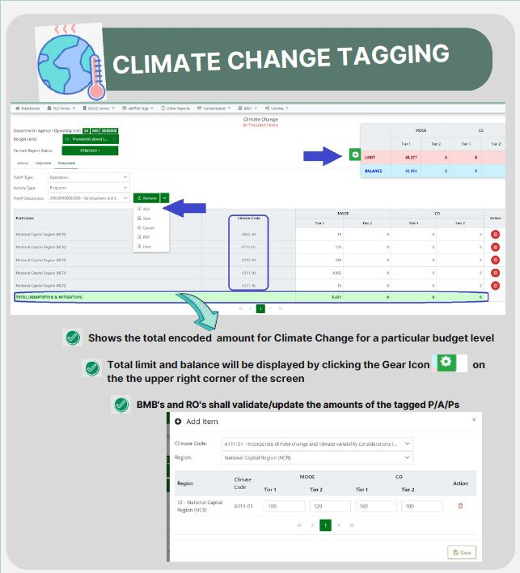
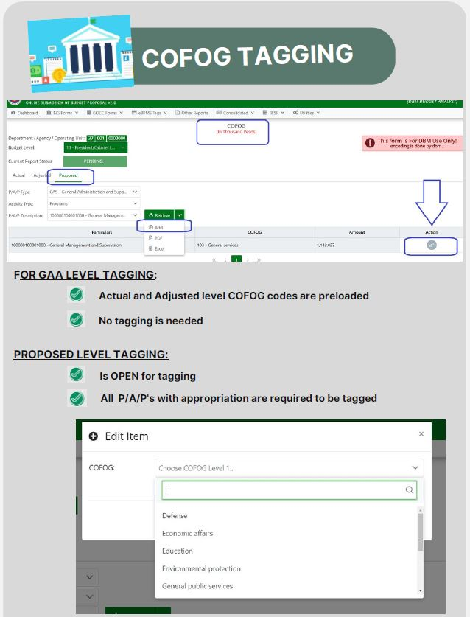
ONLINE SUBMISSION OF BUDGET PROPOSALS
OFFICE OF THE CHIEF INFORMATION OFFICER

Slide 9
ONLINE SUBMISSION OF BUDGET PROPOSALS
OFFICE OF THE CHIEF INFORMATION OFFICER

Slide 10
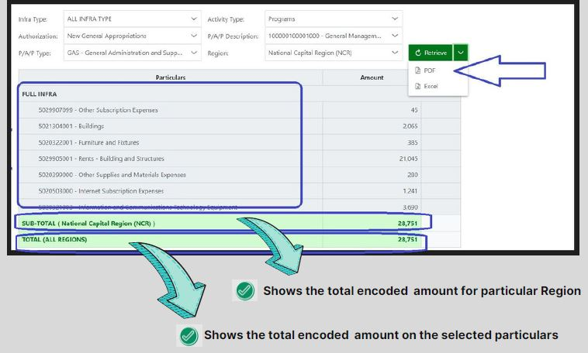
ONLINE SUBMISSION OF BUDGET PROPOSALS
OFFICE OF THE CHIEF INFORMATION OFFICER

Slide 11
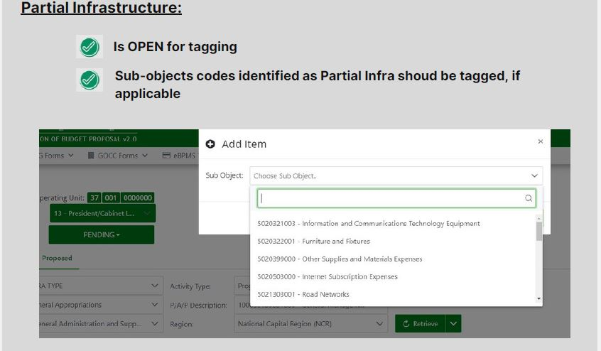
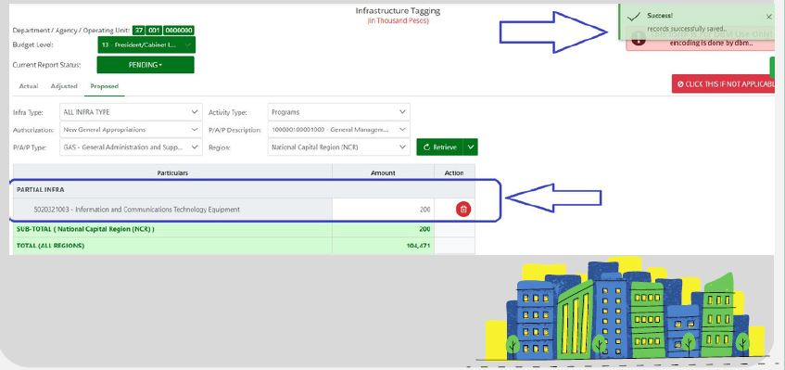
ONLINE SUBMISSION OF BUDGET PROPOSALS
OFFICE OF THE CHIEF INFORMATION OFFICER

Slide 12
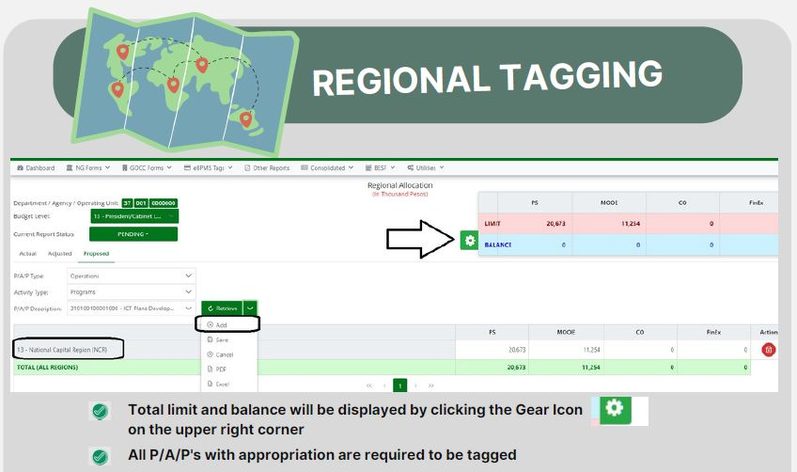
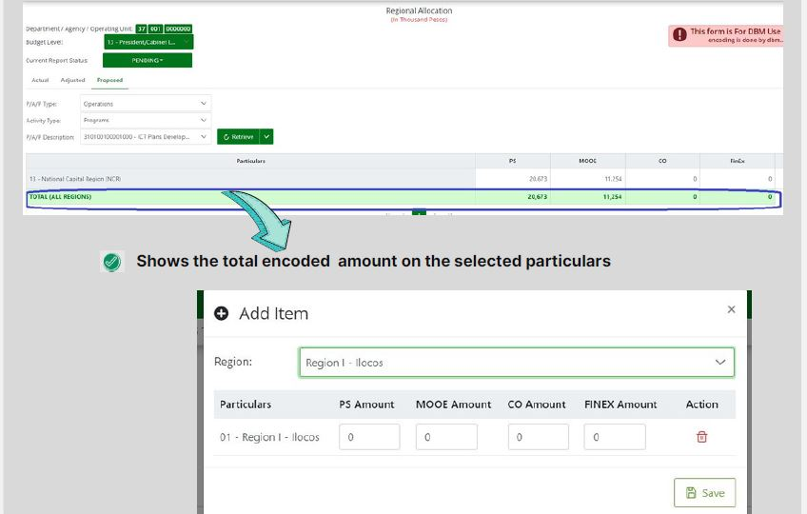
ONLINE SUBMISSION OF BUDGET PROPOSALS
OFFICE OF THE CHIEF INFORMATION OFFICER

Slide 13
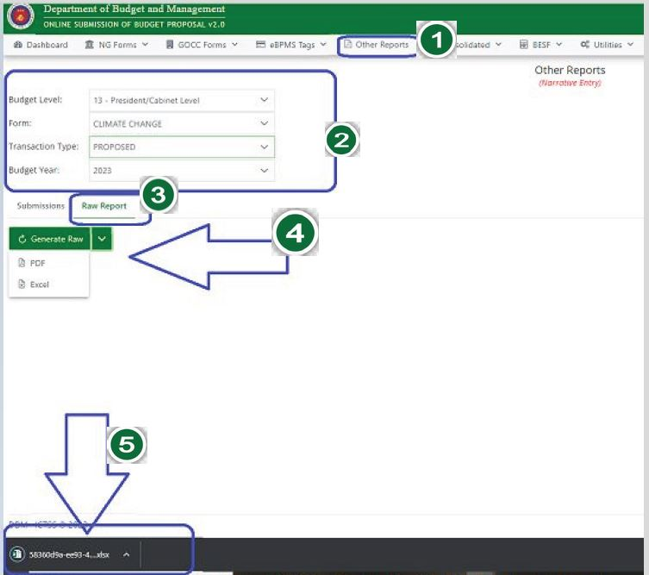
ONLINE SUBMISSION OF BUDGET PROPOSALS
OFFICE OF THE CHIEF INFORMATION OFFICER

Slide 14
DEPARTMENT OF BUDGET AND MANAGEMENT
Office of the Chief Information Officer
Information and Communications Technology Initiatives
Budget Forum
26 January 2023, Thursday

