Slide 1
Salient Features of the FY 2021 National Budget Call
January 15, 2020
Director Mary Anne Z. Dela Vega
DBM – Budget and Management Bureau B
Philippine International Convention Center

Slide 2
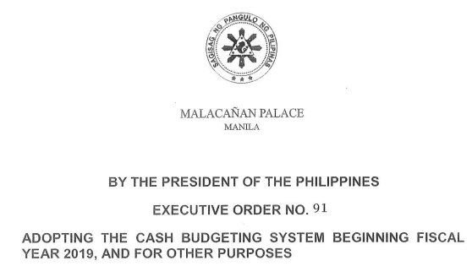
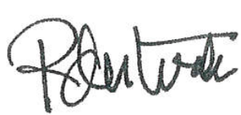
EXECUTIVE ORDER NO. 91

Slide 3
Budget Level
Tier 1
(Ongoing Spending)
Forward Estimates
Tier 2
(New Spending and Expansion of P/A/Ps)
For charging against the available Fiscal Space
Total Proposed
Budget

Slide 4
Definition
TIER 1
TIER 2
Estimated cash requirements for ongoing P/A/Ps and commitments at the same scope and quality
Reallocation of Tier 1 resources among P/A/Ps shall NOT BE ALLOWED
Amount available for Tier 2 proposals corresponds to the fiscal space, or the difference between the projected expenditure program (after considering projected revenues and deficit targets) and Tier 1

Slide 5
Department/Agency Budget Levels
 | Tier 1 | Tier 2
FY 2021 | FY 2021 FEs per Annex A of NBM No.132 | To be accomplished based on: Annex A of NBM 133, and Budget Priorities Framework to be issued in April, 2020
FY 2022 | FY 2022 FEs per Annex A of NBM No.132 * To be updated based on Annex A of NBM 133 | Not applicable
FY 2023 | To be formulated based on Annex A of NBM 133 | Not applicable
NBM 132 – (FY 2020 Budget Priorities Framework) - issued April 2019
NBM 133 – (FY 2021 National Budget Call) – issued November 2019

Slide 6
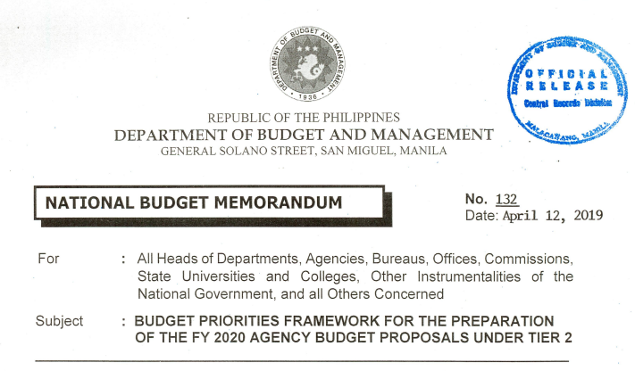
FY 2021 Tier 1
=
FY 2021 FEs
per Annex A of NBM No.132
FY 2021 Tier 1
Any adjustments should be included in the agencies’ Tier 2 budget proposals

Slide 7
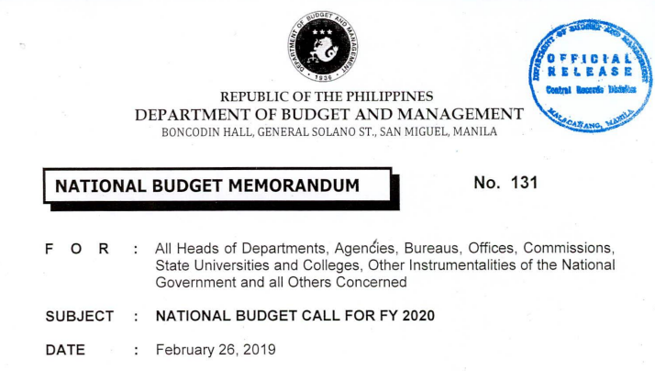
FY 2021 Tier 2
Inclusions in MOOE and CO for Tier 2 stated in the NBM 131 (FY 2020 National Budget Call) shall still be adopted. Except for some new items and revisions.

Slide 8
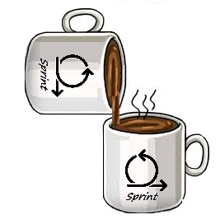
New item: FY 2021 Tier 2
Spill Over Projects
Funding requirements for the continuation of contracts that were delayed in their implementation as of March 31, 2020.
These requirements shall be subject to DBM evaluation.
FY 2020
PROJECTS
FY 2021
PROJECTS

Slide 9
New item: FY 2021 Tier 2
MOOE
Funding requirements to cover transfers from the NG to the LGUs
Internal Revenue Allotment,
Special Shares of LGUs in the Proceeds of National Taxes,
Barangay Official Death Benefits,
Special Shares of LGUs in the Proceeds of Fire Code Fees, and
Bangsamoro Autonomous Region in Muslim Mindanao

Slide 10
Revised item: FY 2021 Tier 2
MOOE
FY 2020
National Budget Call
FY 2021
National Budget Call
Expanded/new ICT P/A/Ps
with BP Form 202, covered by the current ISSP, as endorsed by the MITHI
Expanded/new ICT P/A/Ps
with BP Form 202, as approved by the MITHI Steering Committee (MSC)

Slide 11
Revised item: FY 2021 Tier 2
CO
FY 2020
National Budget Call
FY 2021
National Budget Call
Proposed adjustments in the total cost of an already approved project by the NEDA Board or ICC as of March 31, 2019, which are implementation-ready
New major capital projects to be implemented starting FY 2021, and ongoing major capital projects with updated project scope/cost, implementation and loan validity schedule, and source of financing approved by the NEDA Board and/or Investment Coordination Committee (ICC) as of March 31, 2020

Slide 12
Revised item: FY 2021 Tier 2
CO
FY 2020
National Budget Call
FY 2021
National Budget Call
Expanded/new ICT P/A/Ps
with BP Form 202
Expanded/new ICT P/A/Ps
with BP Forms 202, as approved by the MSC

Slide 13
FY 2022 and FY 2023
Tier 1 / FE inclusions

Slide 14
Policy Guidelines – Tier 1 inclusions
FY 2022 FEs
FY 2023 FEs
Update the FY 2022 Tier 1 level as shown in Annex A of NBM 132, s. 2019, considering the estimated budget that are essential for the continued implementation of existing approved P/A/Ps.
Formulate the FY 2023 FEs using the assumptions considered in updating the FY 2022 FEs.

Slide 15
FY 2022 FEs
2019 Budget Utilization Rate=
Current Year’s
Obligation
Allotment
(for MOOE & CO)
on a per P/A/P of the agency

Slide 16
FY 2022 and FY 2023 Tier 1
Inclusions in MOOE and CO for Tier 1 stated in the NBM 131 (FY 2020 National Budget Call) shall still be adopted. Except for some new items and revisions.

Slide 17
New item: FY 2022 and 2023 Tier 1
MOOE
Approved projects covered by Multi-Year Contracting Authority (MYCA) subject to revision to reflect the cash requirements that shall be paid within the year in consideration

Slide 18
Revised item: FY 2022 and 2023 Tier 1
MOOE
FY 2020
National Budget Call
FY 2021
National Budget Call
ICT P/A/Ps previously covered by existing ISSP as endorsed or approved by the MITHI
ICT P/A/Ps, as approved by the MSC;

Slide 19
Revised item: FY 2022 and 2023 Tier 1
MOOE
FY 2020
National Budget Call
FY 2021
National Budget Call
Infrastructure subsidy support to GOCCs
On-going infrastructure projects of GOCCs with subsidy/equity support, including those with Certificate of Budget Inclusion as approved by respective Boards

