Slide 1
FY 2019 Budget Preparation Forms & Calendar
(Ms. Maria Sofia Tejerero)
Budget Technical Bureau
Notes:
Good morning!

Slide 2
Outline of Presentation
Budget Preparation (BP)Forms
Budget Preparation Calendar
Deadlines and Submission Requirements

Slide 3
Budget Preparation Forms

Slide 4
BP Forms
FROM
TO
PARTICULARS | 2018 BUDGET CALL | 2019 BUDGET CALL
Number of BP forms to be submitted: | 30 | 24
Requiring encoding at the OSBPS | 23 | 21
Generated from OSBPS (BP 201 Summary) | 1 | 1
Manually prepared in excel formats | 6 | 2

Slide 5
Discontinued BP Forms (7)
BP Form No. | Form Title | Remarks
BP 201 (A-1, B-1, C-1 and D-1) | Multi-year Requirements for the Proposed Year Tier 2 Proposal (PS, MOOE, FinEx and CO) | Information in the new BP 201-E (Summary of Out-year Requirements) is sufficient.
BP 201 (E-1) | Matrix of Priority Programs and Participating Agencies | Considered as an attachment to the BP Form 202-A (Convergence Programs and Projects)
BP 400 | ANNUAL GAD PLAN AND BUDGET | Agencies shall submit to PCW the annual GAD plan and budget as well as accomplishment report in the Gender Mainstreaming Monitoring System (GMMS) of the PCW.
BP 400-A | ANNUAL GAD ACCOMPLISHMENT REPORT

Slide 6
Revised BP Forms (7)
BP Form | TITLE
201 | Summary of Obligations and Proposed Programs/Projects
201-A | Obligations for Personnel Services (PS)
201-B | Obligations for Maintenance and Other Operating Expenses (MOOE)
201-C | Obligations for Financial Expenses (FinEx)
201-D | Obligations for Capital Outlays (CO)
202 | Proposal for New or Expanded Locally-Funded Projects
203 | Proposal for New or Expanded Foreign-Assisted Projects

Slide 7
Revised BP Form: BP 201 Summary
FROM: 2018 BUDGET CALL
TO: 2019 BUDGET CALL
To be accomplished in a new form BP 201-E (Summary of Out-year Requirements)

Slide 8
Revised BP Form: BP 201 Schedules A, B, C and D Deletion of Continuing Appropriations from the box on Appropriation Sources
Reminders:
Obligations funded from FY 2016 Appropriations should be included in the FY 2017 Actual obligations
The following P/A/Ps, should be separately presented from the Regular agency budget funded under the new GAA:
New appropriations transfers from SPF/Supplemental Appropriations
Automatic Appropriations.

Slide 9
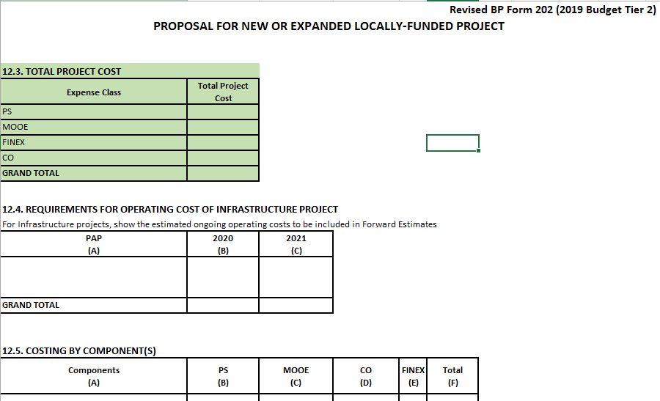
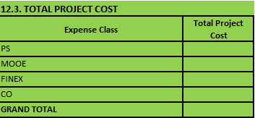
Revised BP Form: BP 202 Incorporation of total cost of the project (Box No. 12.3) , by expense class, including the requirements for the out-years for multi-year projects.

Slide 10
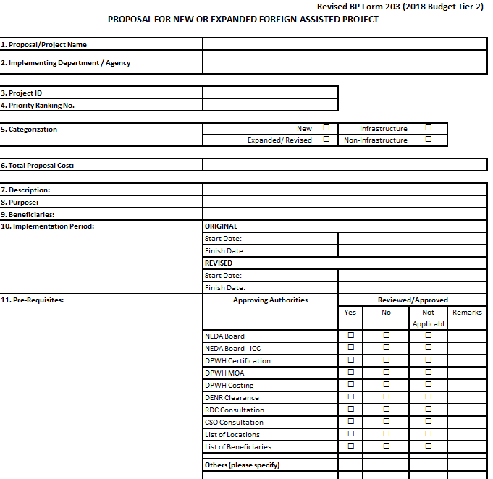
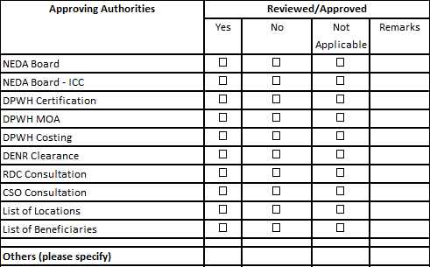
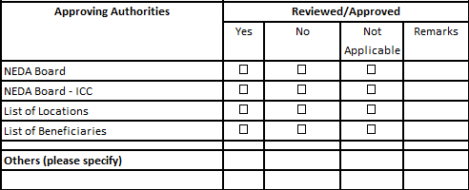
Revised BP Form: BP 203 Shortening the preparation process through reduced number of approving authorities
FY 2018 Budget Call
FY 2019 Budget Call

Slide 11
New BP Form: BP 201-E Specific Form to reflect Consolidated Out-year Requirements, by allotment class
Reminders:
To be prepared Manually in excel format, by PAP, by Allotment Class (only)
Funding Requirements for 2020 & 2021 Tier 1 should be based on the forward estimates as agreed upon between DBM and agencies.
Indicate also the Impact of the 2019 Tier 2 proposals to 2020 and 2021 separately.

Slide 12
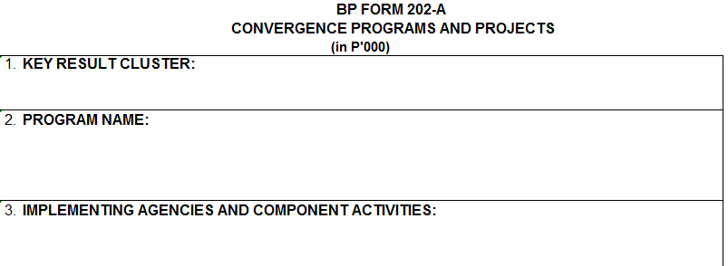
Renamed BP Form:
FY 2018 Budget Call
FY 2019 Budget Call

Slide 13
FY 2019 Budget Preparation Calendar

Slide 14
Timelines to Remember in the FY 2019 Budget Preparation Calendar
Submission (thru OSBP) of B.P. Form Nos. 201 A, B, C, D
– Past Year’s Actual Obligation - Feb 2, 2018
Consultation with Agencies on the Formulated FY 2019 Tier 1 Level- Feb 1-Mar 2, 2018
Sending of Confirmation Letters for Tier I Level to Agencies - Mar 14-16, 2018
Deadline of Submission - April 19, 2018
1. Thru OSBPS: CY 2019 Budget Proposals Tiers 1 (FEs) and 2 (New Spending)
2 Manually-prepared: a.) Summary of Out-year Requirements
b.) Convergence Programs & Projects
Conduct of Technical Budget Hearings for Tier 2
(New Spending) Proposals - May 2 - 25, 2018

Slide 15
Timelines to Remember in the FY 2019 Budget Preparation Calendar
Sending of Confirmation Letters to Agencies of the
Total Budget Levels (Tiers 1 and 2) - Jun 4-6, 2018
Printing of CY 2019 Budget Documents - Jun 25 - Jul 6, 2018
Submission of the CY 2019 President's Budget to Congress
(Day of the State of the Nation Address) - July 23, 2018

Slide 16
Deadlines and Submission Requirements
PARTICULARS | SUBMISSION REQUIREMENT | FORMAT
February 2, 2018
1. FY 2017 Actual Obligations | 1. BP Form 201 – Summary 2. BP Form 201 (Schedules A, B, C, & D) | OSBPS-generated hard copies (in triplicate)
2. FY 2017 – 2021 Revenue Program | BP Forms 100 and 100-A, B and C
April 19, 2018
1. Details of FY 2019 Tier 1 (FEs) 2. FY 2019 Tier 2 Budget Proposals | 1. All BP Forms (except BP Form 201-E & BP 202-A) 2. Tier 2 justification letter 3. Thrust/Priorities for the Budget Year 4. Program/Project Implementation Strategies for FY 2019 5. FY 2017 Actual Physical Accomplishment 6. Inventory of Equipment as Required under NBC Nos. 438, 446 and 446-A | OSBPS-generated hard copies (in triplicate)
3. Supporting documents
 |  | Hard Copy (in triplicate)
4. Summary of Out-year Requirements | BP Form 201-E | Excel-format hard copies (in triplicate)
5. Convergence Programs & Projects | BP Form 202-A

Slide 17
Submission Requirements
BP Form 300 (FY 2019 Proposed Provisions)
Incomplete forms will not be considered in the evaluation of proposed special and general provisions.
BP Form C (Summary of RDC Inputs and Recommendations on Agency New and Expanded Programs and Projects)
ACOs to provide feedback to RDC on the actions taken relative to the proposals and the reasons therefor by furnishing RDC of the copy of BP Form C as submitted to DBM.
BP Form 202/203
Required submission for all Tier 2 proposals, including MITHI-endorsed ICT proposals

Slide 18
Submission Requirements – Specific Procedures
Budget Proposal submissions should cover only those activities to be implemented within the CALENDAR YEAR 2019 (January to December 2019 only), not the requirements for the whole Academic Year (June 2018 to March 2019)
DepEd
SUCs
DND – PMA, NDCP
DILG - PPSC
DOST - PSHS
OEO - TESDA

Slide 19
Submission Venue
Administrative Service – Central Records Division (AS-CRD), Ground Floor, DBM Building III, General Solano Street, San Miguel, Manila
Agencies

Slide 20
THANK YOU

Slide 21
2019 Budget Preparation Forms & Calendar

