Slide 1
MISREPRESENTATION
And NOT MISINTERPRETATION

Slide 2
Dates are in numeric format: mm/dd/yyyy
Specifics should be given to “Others” response in the civil status field.
For holders of foreign/dual citizenship, please select from the dropdown list the foreign country where you were born/naturalized or type/write the same in the space provided therein.
If not applicable, please write N/A

Slide 3
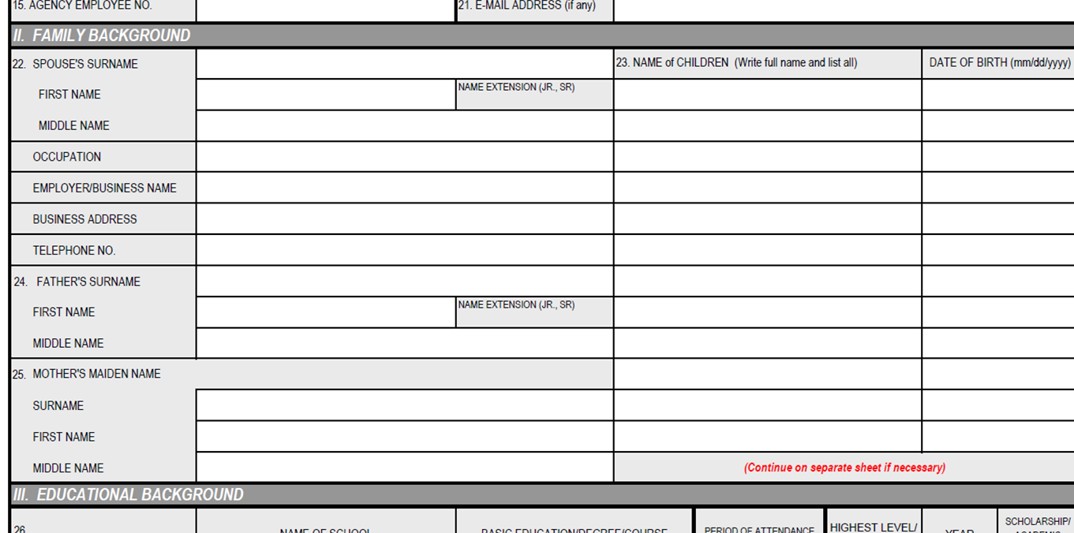
Mother’s name is her maiden name, or name when she was single or before marriage.
List full names (first name and surname) of ALL your children.
Date of birth is in numeric format: mm/dd/yyyy
If not applicable, please write N/A

Slide 4
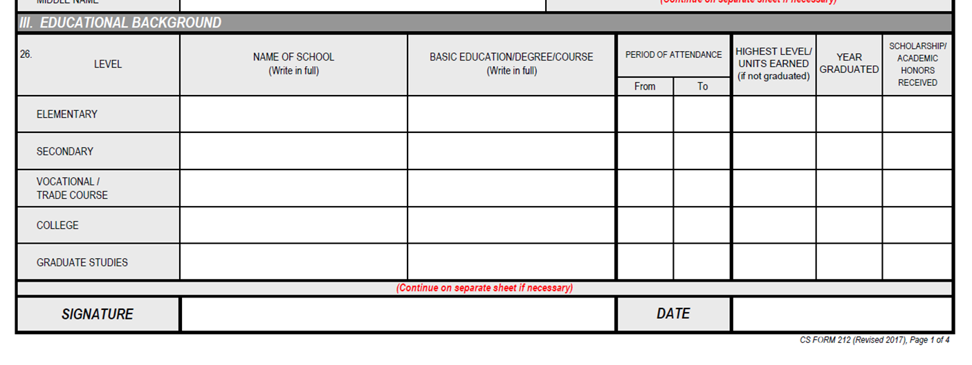
Indicate FULL name of schools. DO NOT ABBREVIATE.
For Elementary Level, indicate PRIMARY EDUCATION if graduated
For Secondary Level, indicate HIGH SCHOOL if graduated under the old curriculum; or JUNIOR HIGH SCHOOL or SENIOR HIGH SCHOOL if graduated under the K-12 curriculum.
Indicate in FULL all courses taken in college (e.g. ASSOCIATE IN ARTS, AB ECONOMICS, BS PSYCHOLOGY, MA IN HISTORY).
Indicate all masters or doctorate degrees taken.
If graduated for every level, indicate year of graduation.
If not graduated in any level, indicate the highest grade, level or units earned.
Period of attendance are stated in school years (e.g. 1992-1996)
Indicate any scholarship and/or academic honors received in each level.
If not applicable, please write N/A

Slide 5
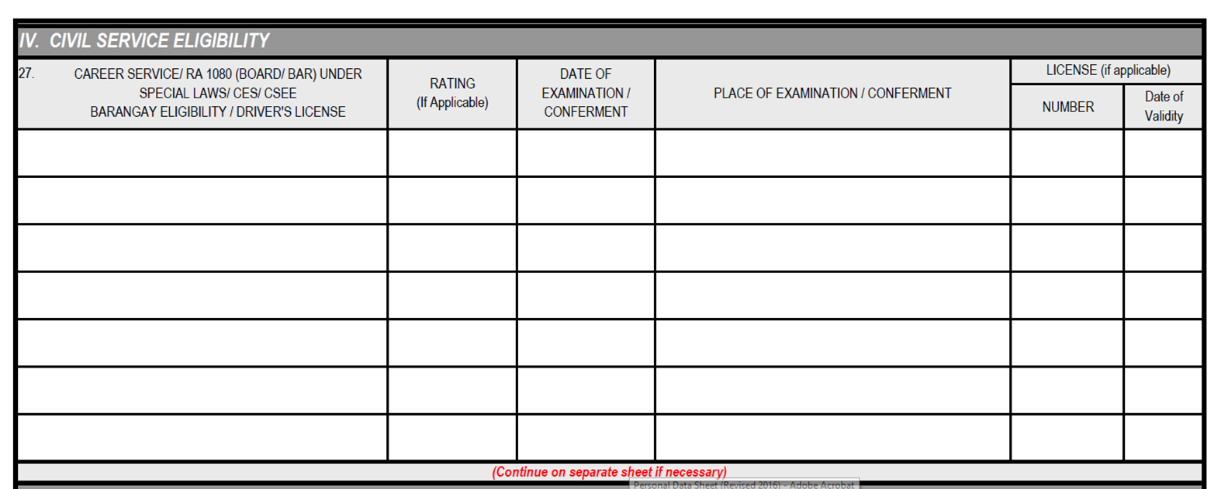
Indicate all civil service eligibilities earned with corresponding rating, date and place of examination/conferment.
Example:
Career Service Sub-Professional EO132/790 – Veteran Preference Rating
Career Service Professional PD 907 – Honor Graduate
Career Service Executive RA 7883 – Barangay Health Worker
Stenographer
Barangay Official
PD 997 – Scientific and Technological Specialist
If earned eligibility entails a license (RA 1080), indicate the license number and its date of validity.
If not applicable, please write N/A

Slide 6
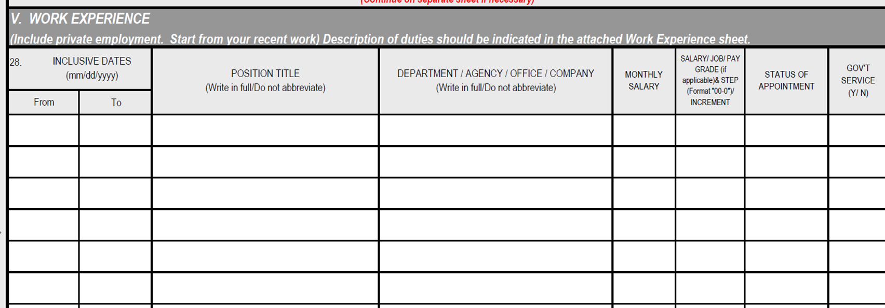
Indicate all positions held both in the public and private employment starting from current work.
Inclusive dates are indicated in numeric format: mm/dd/yyyy.
Indicate FULL position titles and COMPLETE NAME of department/agency/office/company. DO NOT ABBREVIATE.
Indicate monthly salary in figures (e.g. P21,877).
Salary grade and salary step, if applicable, should be stated in the format ”00-0” (e.g. 24-2, 24 for salary grade, 2 for salary step)
Indicate status of employment (e.g. permanent, temporary, casual, contractual)
Indicate “yes” under government service if position held is in the public or government employment or “no” if held in the private employment.
If not applicable, please write N/A

Slide 7
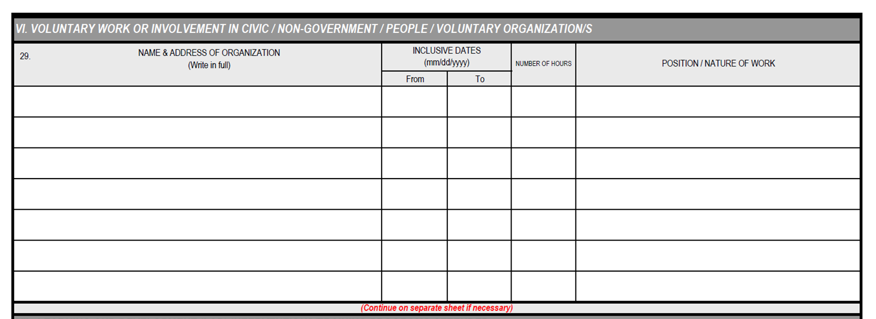
Indicate the FULL name and address of the organization where involved as voluntary worker.
Inclusive dates, start (from) and end (to) should be in numeric format: mm/dd/yyyy.
Indicate the number of hours of voluntary work rendered.
Indicate the position/nature of voluntary work rendered.
If not applicable, please write N/A

Slide 8
Indicate FULL titles of learning and development (L&D) interventions attended during employment. Indicate list from the most recent L&D.
Inclusive dates of attendance, start (from) and end (to) should be in numeric format: mm/dd/yyyy.
Indicate the number of hours attended for program.
Indicate the type of L&D intervention (e.g. managerial, supervisory,technical, foundation ).
Indicate the FULL name of institution/agency that conducted or sponsored the program. DO NOT ABBREVIATE. (e.g. CSC should be Civil Service Commission).

Slide 9
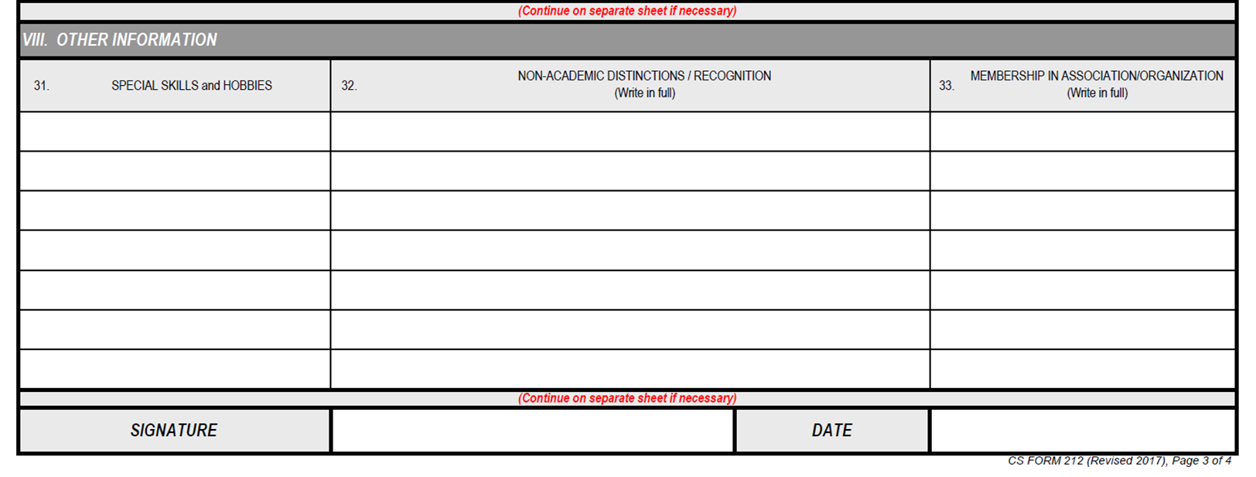
Indicate special skills /hobbies.
Indicate in FULL non-academic distinctions/recognition (awards received)
Indicate membership in any professional association/organization by writing in FULL said association/organization.
If not applicable, please write N/A

Slide 10
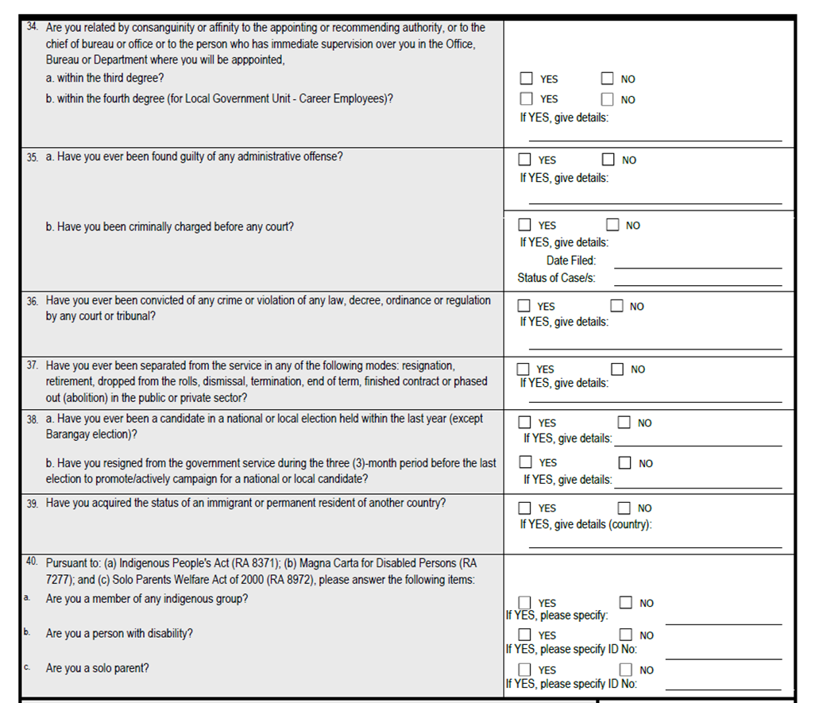
# 34-40
Indicate response to questions 34 to 40 on the right side of the sheet.
Provide details or specifications for any yes response.
If not applicable, please write N/A

Slide 11
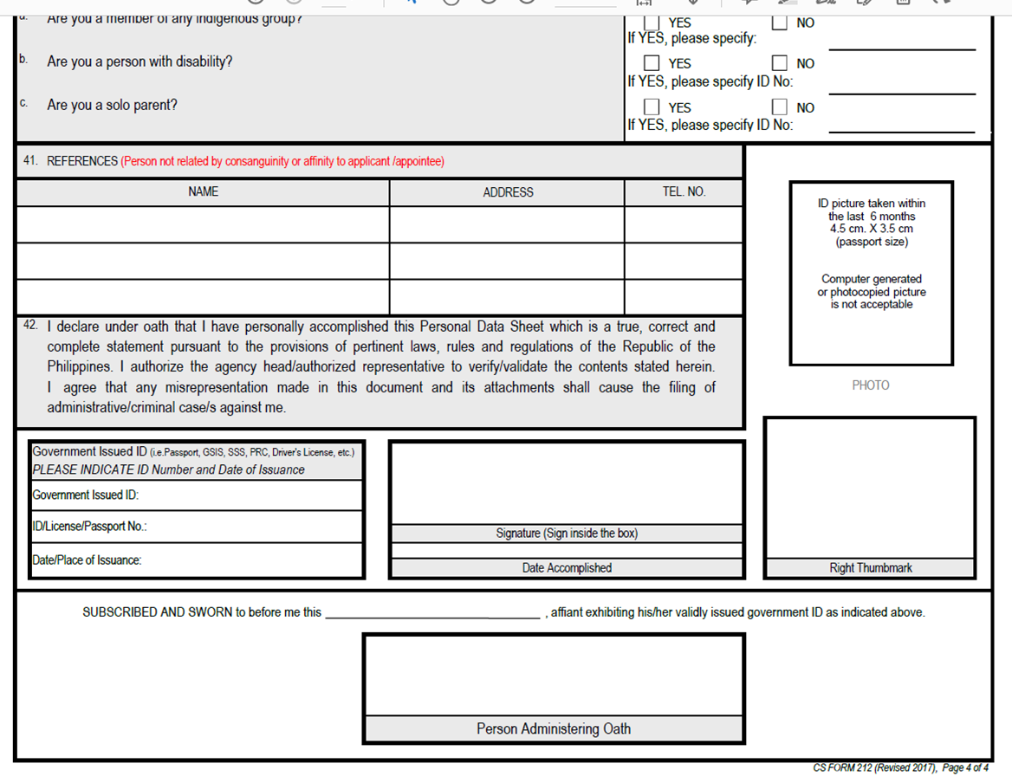
# 41 References
Indicate the FULL name of references with the format FIRST NAME, MI, SURNAME, their addresses and respective telephone numbers.
# 42 Declaration
As agreement to and for completion of the PDS, the employee’s signature and right thumb mark should be affixed in the boxes provided. Indicate also the government ID number and date of issuance in the boxes provided.
Attach a RECENT PASSPORT SIZE (4.5 cm. x 3.5 cm.) picture. Picture must be taken within the last six (6) months. Computer generated or photocopied picture is not acceptable.
If not applicable, please write N/A

Slide 12
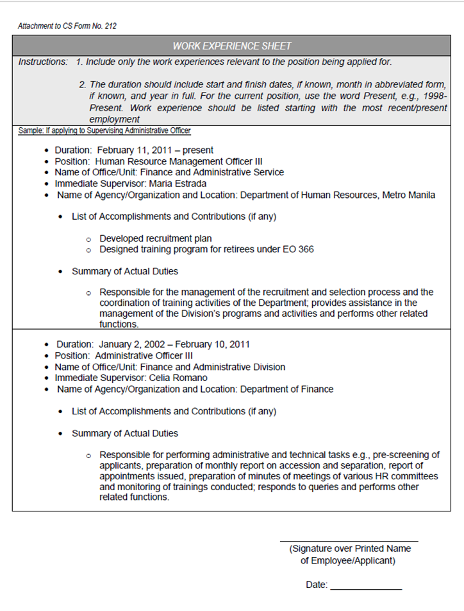
Work Experience Sheet
Work experience should be accomplished and submitted together with the PDS in case of application to a vacant position. This should be accomplished only for work experience relevant to the position being applied to.

